Slide 1


Utilization Analysis
Analysis Performed by Pitt MQE Class of 2023
Presented by Megan Kveragas and Victoria Burford

Slide 2


Project Overview
Individual Analysis
Group Analysis
Today’s Presentation
Notes:
M, X

Slide 3
Data Process & Manipulations
Before calculating utilization rates we took out:
PTO
Company Holidays & Weekends
Contractors
We visualized utilization across all months
We explored other variables of interest including:
Contractor Hours, Length of Projects, & PTO
Notes:
M, X

Slide 4
UTILIZATION CHARACTERISTICS
Notes:
T

Slide 5
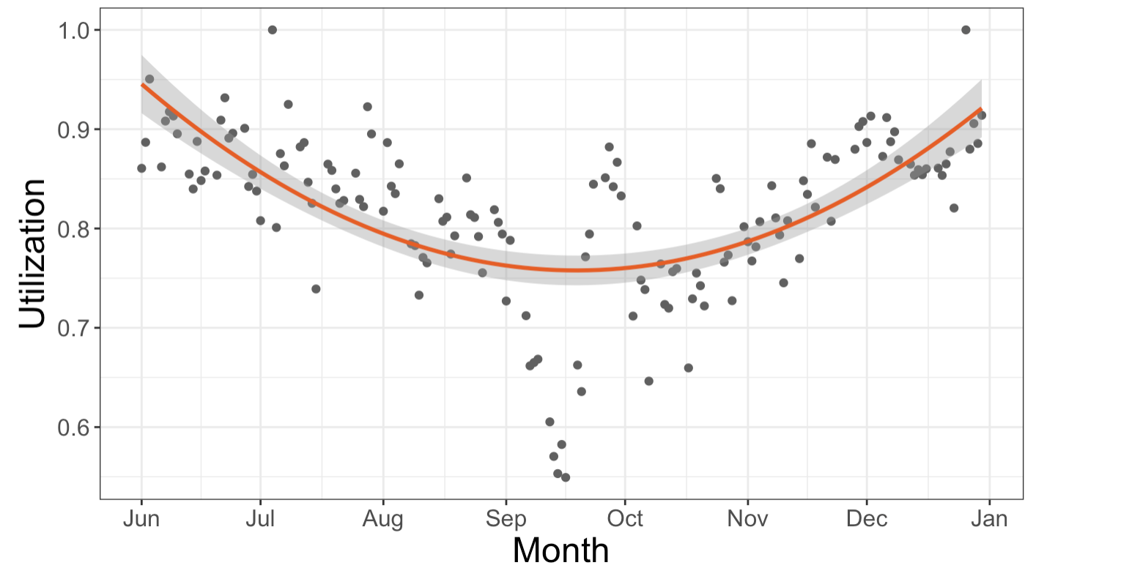

Company Wide Average Daily Utilization
Notes:
T, International Manufacturing Technology show. Talk about dip at 7.5
9/12-9/16

Slide 6
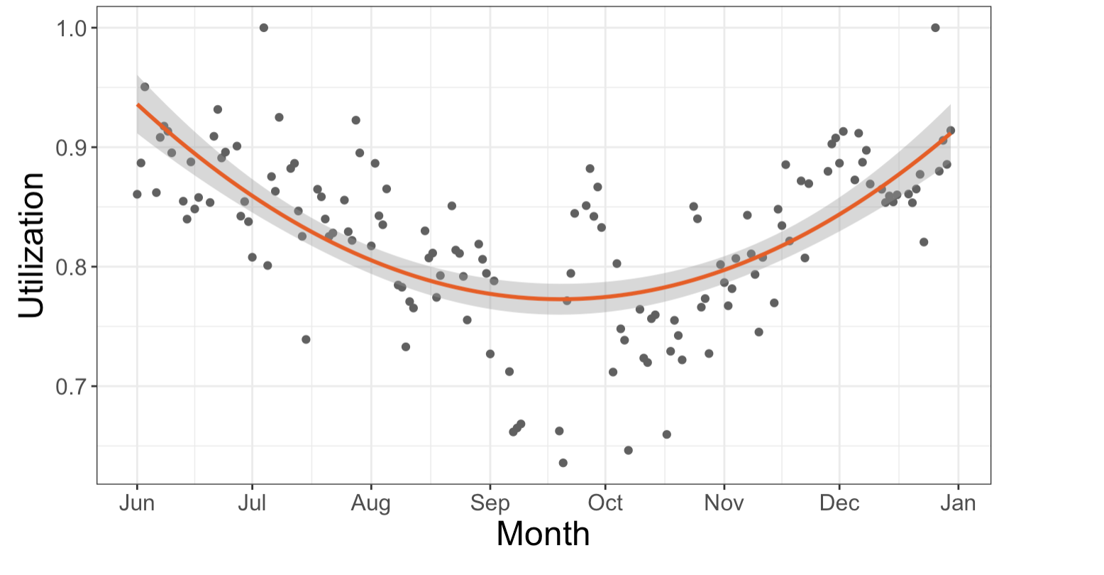
Without Conference, Trend Still Holds
Notes:
T, X

Slide 7
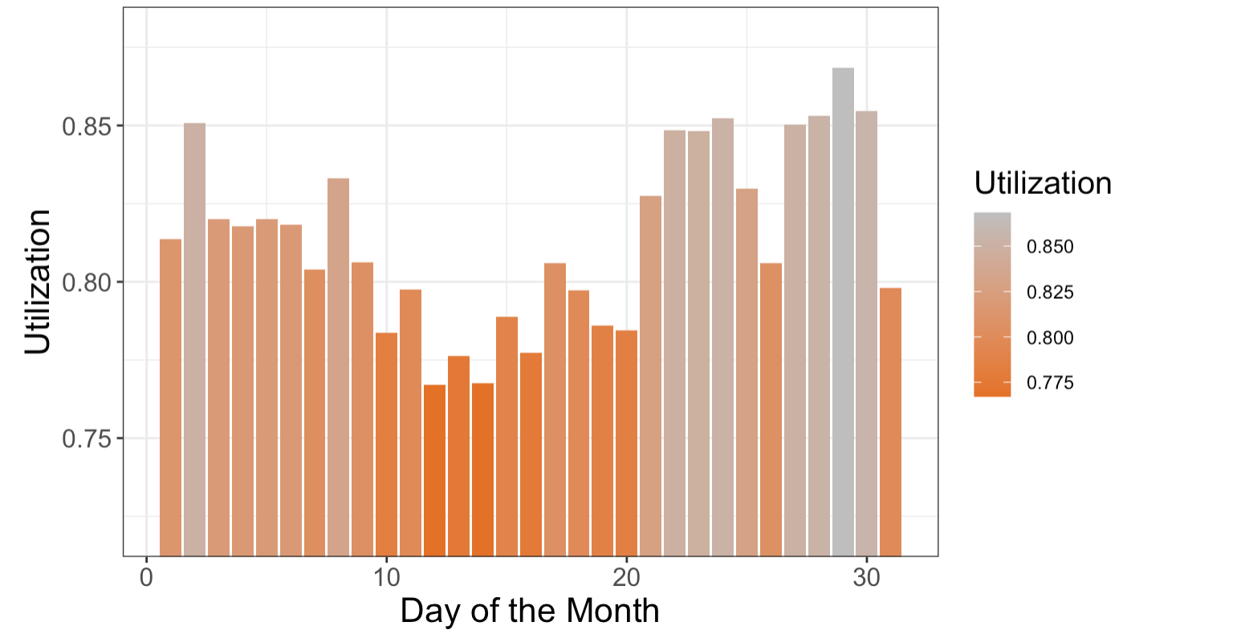
Does Day of the Month Matter?
Notes:
T, Move to weekly

Slide 8
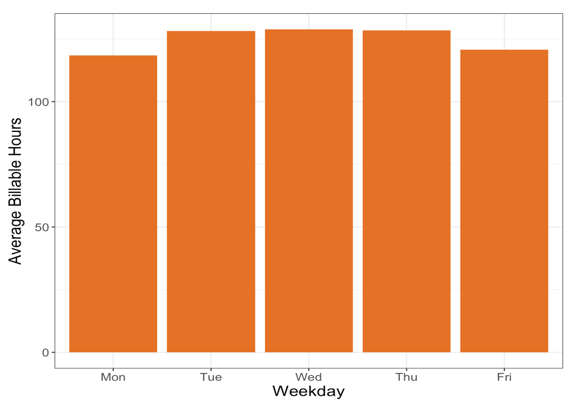
Does Day of the Week Matter?

Slide 9
PROJECT
CHARACTERISTICS

Slide 10
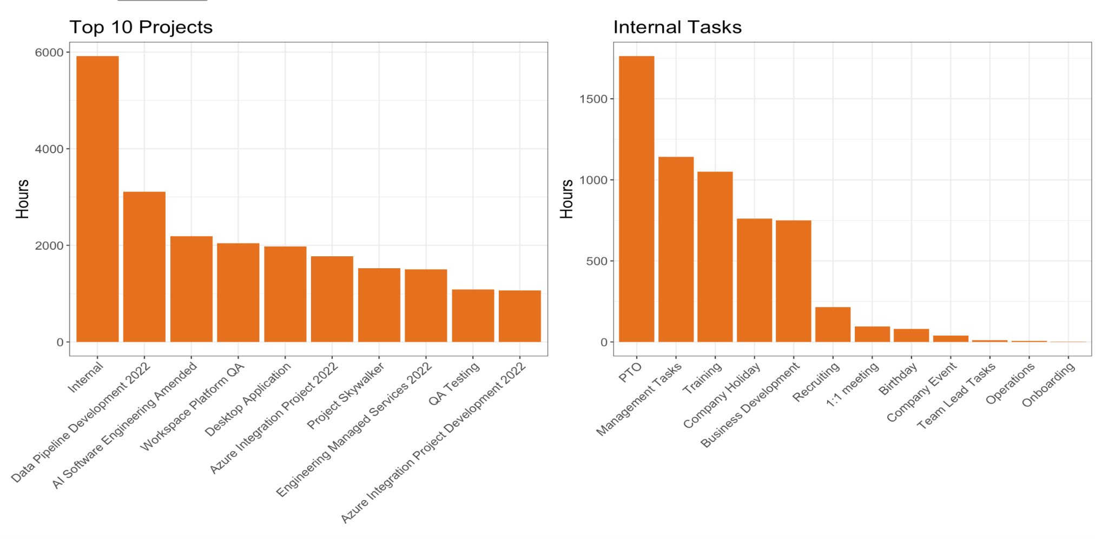
Time Duration Across Projects
Notes:
T, 37 total projects

Slide 11
PTO & CONTRACTORS

Slide 12
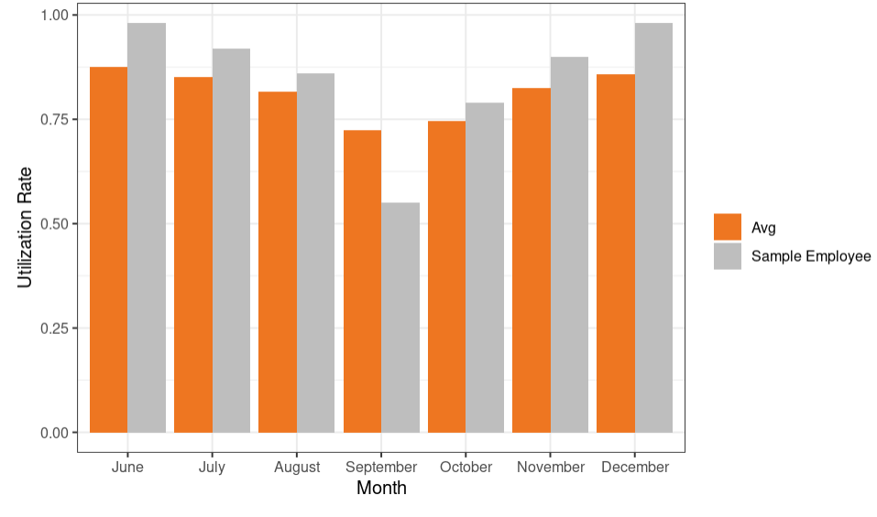
Performance Review Visualization Tool
Notes:
M, change key name
I have reworked my code so that these numbers do NOT include PTO nor Company Holidays
***Turns Dan from just subtly passing to an excellent employee*** which he should be because PTO shouldnt fight against him
A little Fuzzy on the big screen

Slide 13
PTO

Slide 14
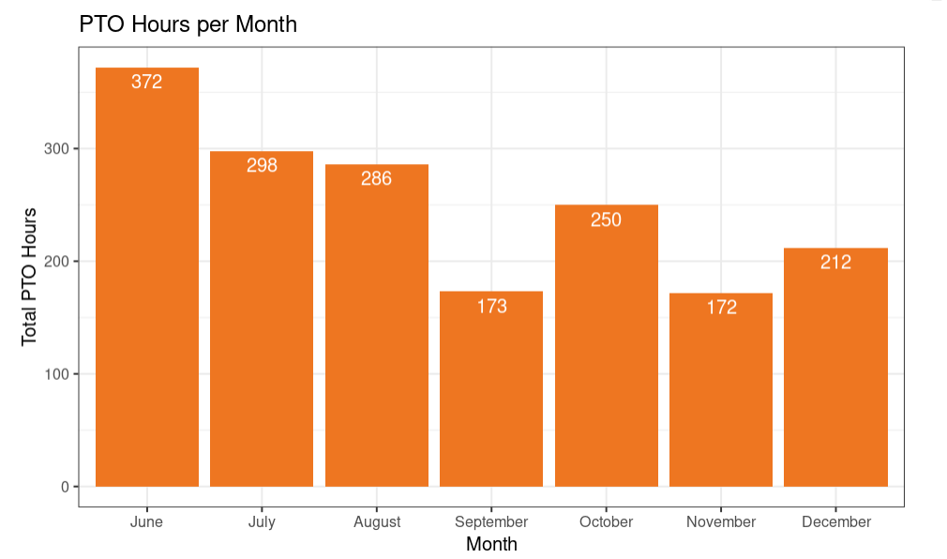
Distribution of PTO Hours Across 6 Months
Notes:
M,

Slide 15
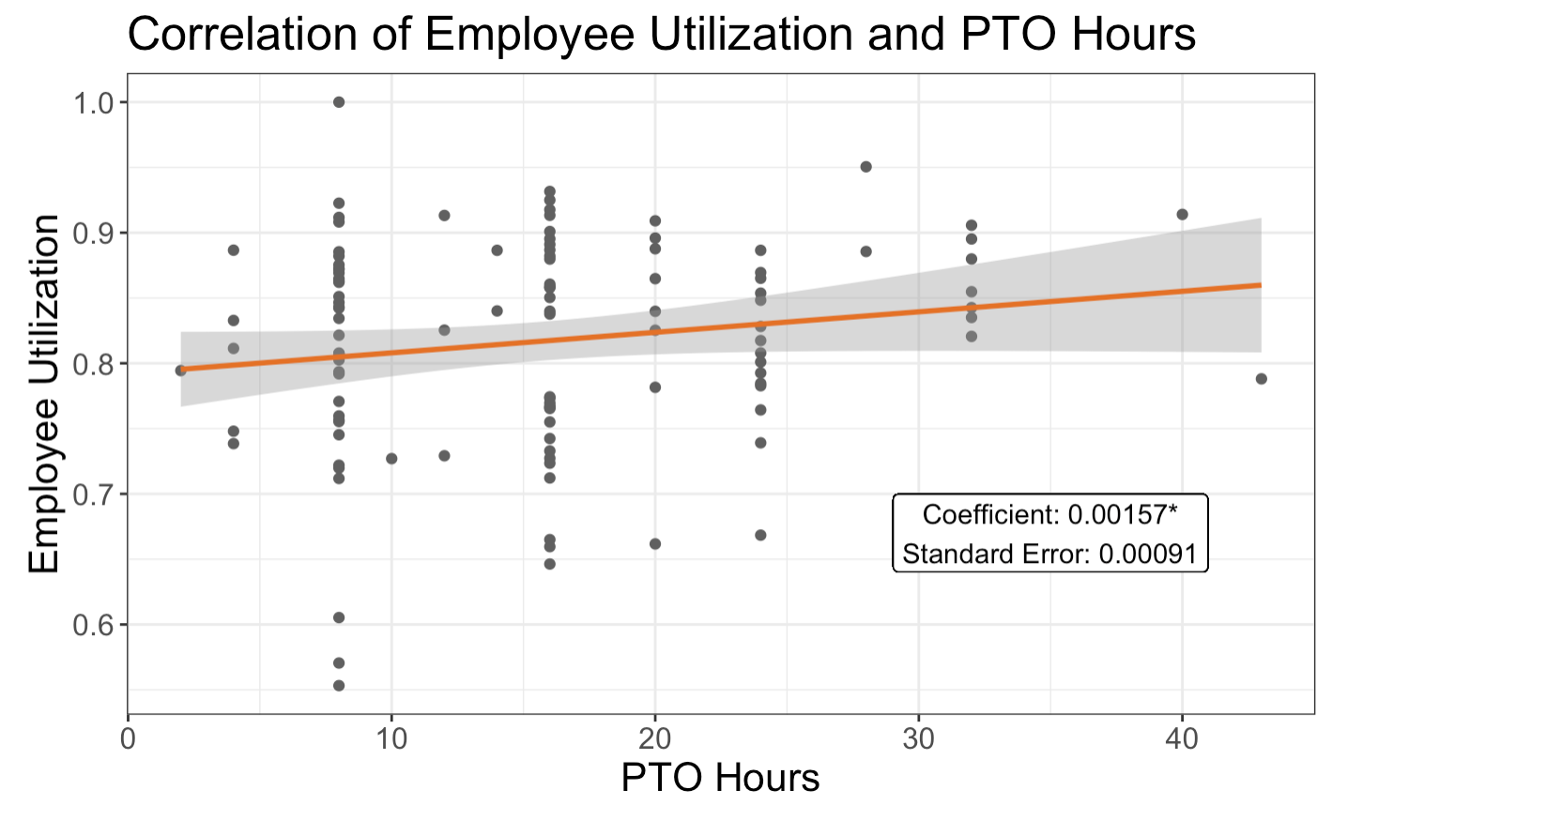
More PTO Suggests Higher Utilization?
Notes:
M

Slide 16
CONTRACTORS

Slide 17
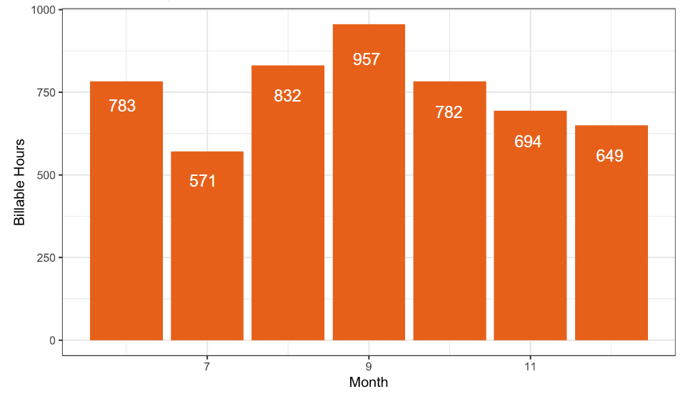
Monthly Billable Hours for Contractors
Notes:
T: Explain x and y axis, reverse pattern than by-day utilization from earlier, X

Slide 18
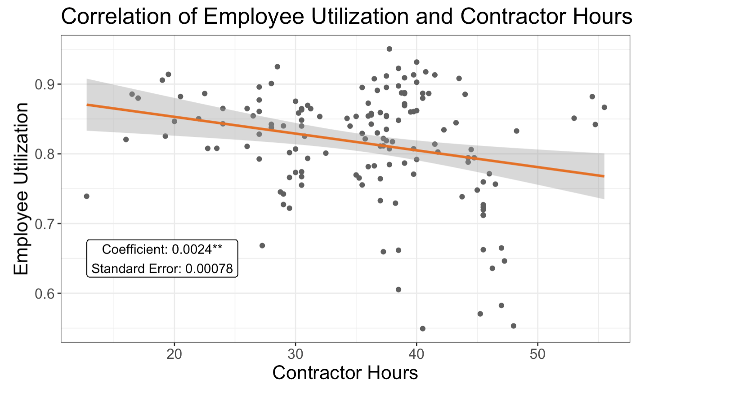
Contractor Hours Increase → Emp. Utilization Decrease
Notes:
T, X

Slide 19
Main Highlights
Comparing an employees utilization to the average can be used to track performance
Monthly utilization appears to follow a cycle
Utilization has a positive relationship with PTO, but the relationship is not very significant
Notes:
T,

Slide 20
Passing the Baton
Confirm that utilization is related to fiscal quarters
Assess project lifecycles & accumulation over multiple years
Look into patterns with new hires & quantify value of retention
Reveal a clearer relationship between PTO & Utilization
Notes:
M: To be passed on…
New Hire/ Value of Employee Retention
More accurate picture of PTO impact on Utilization and frequency of PTO

Slide 21

A Message From Pitt MQE 2023
Thank you to Ben Wilson and the entire Rivers Agile Team for allowing us to:
Come up with solutions to an interesting and applicative problem
Use our skills to analyze and visualize your data
Be creative throughout this process
Visit your space and network with you all!
Notes:
M

Slide 22

Questions?

